Slide 1

Computer Graphics
Dr. Lucy J. Gudino
Computer Science & Information Systems Group
Birla Institute of Technology & Science, Pilani, Goa Campus

Slide 2
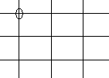

So far…
screen is divided into rows and columns
intersection ➔ pixels
Rasterization : Process of determining which combination of pixels provide best approximation to the desired line
Rendering : is the process of generating an image from a model
Scan conversion
Four requirements for drawing a line

Slide 3
Basic Primitive (Contd…)

Slide 4
Line drawing algorithms
The Cartesian slope intercept equation for a straight line is
y = m . x + b
Where ‘m’ is the slope and ‘b’ is the y intercept
Basic Algorithm
  Find equation of line that connects two points P and Q
  Starting with leftmost point P, increment x_{i} by 1 to calculate y_{i} = mx_{i} + b
  where m = slope, b = y intercept
  Intensify pixel at (x_{i}, Round(y_{i})) where
  Round (y_{i}) = Floor (0.5 + y_{i})

Slide 5
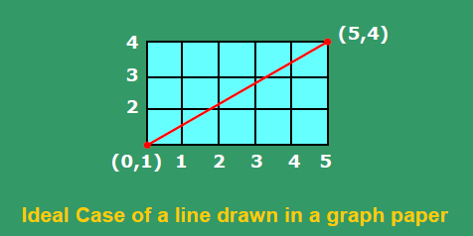
Example
Take an example,b = 1 and m = 3/5.
Then x = 1, y = round(8/5) = round (1.6)➔ 2
x = 2, y = round(11/5) = round (2.2) ➔ 2
x = 3, y = round(14/5) = round (2.8) ➔ 3
x = 4, y = round(17/5) = round (3.4) ➔ 3
x = 5, y = round(20/5) = round (4.0) ➔ 4

Slide 6
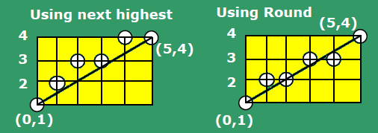
Contd…
x | y_{i} | round(y_{i}) | Next highest
1 | 1.6 | 2 | 2
2 | 2.2 | 2 | 3
3 | 2.8 | 3 | 3
4 | 3.4 | 3 | 4
5 | 4.0 | 4 | 4

Slide 7
Example
Draw a line from P0 (0, 1) to P1(3, 10)

Slide 8
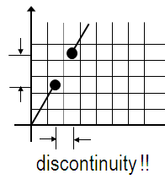
Drawbacks
`*´ and `/´ are expensive
Round() function needed
What if line slope > 1?
  More gaps in the line
Notes:
Example : y = 5.x + 2

Slide 9
The basic Incremental Algorithm
y_{i}= m . x_{i} + b
Y_{i+1}= m . x_{i+1} + b
Y_{i+1}= m . (x_{i} + Δx) + b
Y_{i+1}= y_{i} + m. Δx
If Δx = 1, then y_{i+1} = y_{i} + m
At each step, we make incremental calculations based on preceding step to find next y value

Slide 10
Problem
Draw a line from P0 (0, 1) to P1(5, 4)
Draw a line from P0 (0, 1) to P1(3, 10)

Slide 11
Contd…
Incremental technique avoids the need to deal with y intercept
If |m| >1, a step in x creates a step in y that is greater than 1. Thus, we must reverse the roles of x and y by assigning a unit step to y and incrementing x by Δx = Δy/m
This algorithm is also known as digital differential analyzer (DDA) algorithm as it traces out successive (x, y) values by simultaneously incrementing x and y by small steps proportional to the first derivative of x and y

Slide 12
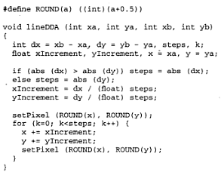
DDA Algorithm

Slide 13
Example
Using DDA algorithm, rasterize the line (0,0) to (6,7).
Using DDA algorithm, rasterize the line (0,0) to (-5,5).

Slide 14
DDA algorithm…
Faster method
Eliminates multiplication
Accumulation of round-off error: pixel positions may drift
Rounding and floating point arithmetic is still a problem (Computationally Intensive)

Slide 15
Midpoint Line Algorithm
Incremental Algorithm
Given the choice of the current pixel, which one do we choose next : E or NE?
Equations:
  y = (dy/dx) * x + B ..(1)
  F(x,y) = a*x + b*y + c = 0 ..(2)
Express (1) in the form of (2)
F(x,y) = dy*x - dx*y + B*dx = 0
a = dy, b = -dx, c = B*dx

Slide 16
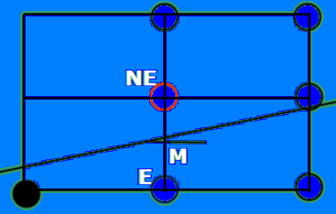
Contd…
Basic Idea: is to Evaluate the mid-point, M, wrt the equation of the line and to choose E or NE
F(x,y) = dy*x - dx*y + B*dx =0
F(x,y) > 0; if ‘M’ below the line
F(x,y) < 0; if ‘M’ above the line

Slide 17
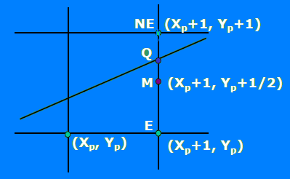
Choose NE since Q is above M
F(M) > 0

Slide 18
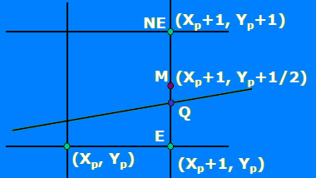
Choose E since Q is below M
F(M) < 0

Slide 19
Algorithm
If F(M) > 0
then Select NE /*M is below the line*/
else Select E ; /*M is above the line*/
/* also with F(M) = 0 */

Slide 20
Contd…
Evaluate mid-point M using a decision variable d = F(X,Y);
At M, d = F(Xp+1,Yp+1/2)
= a(Xp+1)+b(Yp+1/2)+c;
Set d_{old} = d;
Based on the sign of d, choose E or NE.
Case I: If the option is E
  d_{new} = F(Xp+2,Yp+1/2)
  = a(Xp+2) + b(Yp+1/2) + c
  (Δd)_{E} = d_{new} - d_{old} = a /* = dy */

Slide 21
Contd…
Case II: If the option is NE
  d_{new} = F(Xp+2,Yp+3/2)
  = a(Xp+2) + b(Yp+3/2) + C
  (Δd)_{NE} = d_{new} - d_{old} = a + b /*= dy – dx */
Update using d_{new} = d_{old} + Δd

Slide 22
Midpoint Algorithm
d = F(M) = F(Xp+1, Yp+1/2);
if d > 0 choose NE
else /* if d <= 0 */ choose E ;
Case E : increment M by 1 in x
d_{new}= F(M_{new}) = F(Xp + 2, Y + 1/2)
(Δd)_{E} = d_{new} - d_{old} = a ➔ dy
(Δ d)_{E} = dy
Case NE: increment M by 1 in both x and y
d_{new} = F(M_{new}) = F(Xp + 2, Yp + 3/2)
(Δd)_{NE} = d_{new} - d_{old} = a + b ➔ dy - dx
(Δd)_{NE} = dy - dx

Slide 23
Initial value of ‘d’
d_{start} = F(x0 + 1, y0 + 1/2)
= ax0 + a + by0 + b/2 + c
= F(x0, y0)+ a + b/2
= dy - dx/2
Get rid of the fraction
    dstart = 2dy – dx ;
    (Δd)_{E} = 2dy ;
    (Δ d)_{NE} = 2(dy - dx) ;

Slide 24
The Midpoint Line Algorithm
Given : (x₀, y₀) and (x₁, y₁)
Let x = x₀ ; y = y₀;
dy = y₁ – y₀; dx = x₁ – x₀;
d = 2dy – dx ;
(Δd)_{E} = 2dy ;
(Δ d)_{NE} = 2(dy - dx) ;
Plot_Point(x,y)

Slide 25
The Midpoint Line Algorithm……
while (x < x₁)
    if (d <= 0) /* Choose E */
      d = d + (Δd)_{E} ;
    else /* Choose NE */
      d = d + (Δ d)_{NE};
      y = y + 1
    endif
    x = x + 1 ;
    Plot_Point(x, y) ;
end while

Slide 26
Example
Starting Point: (4, 8)
Ending Point : (9,12)

Slide 27
Advantages
Based on incremental method –
no round off function
only integer arithmetic

Slide 28
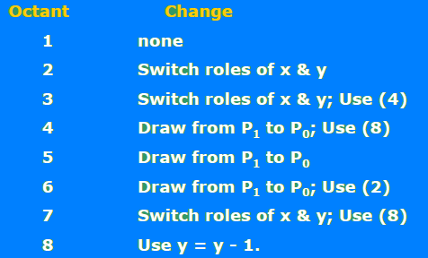
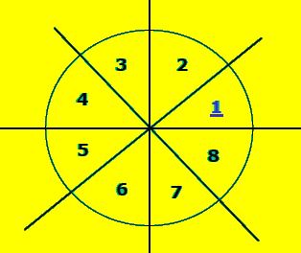
Contd……

Slide 29
Contd……
Draw from P1 to P0:
    swap(P0, P1).
    Use y = y - 1; dy = -dy;
Switch Roles of X & Y:
    Swap (x1, y1);
    Swap (x0, y0 );
    Swap (dx, dy);
    plot_point(y, x);

